Slide 1
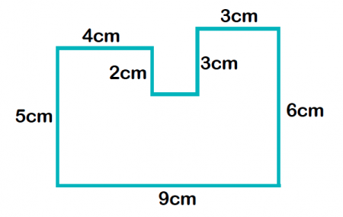
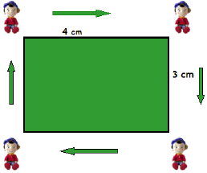
My Measurement Interactive Notebook
Name
Class:
Teacher:
Term 3 Semester 2

Slide 2
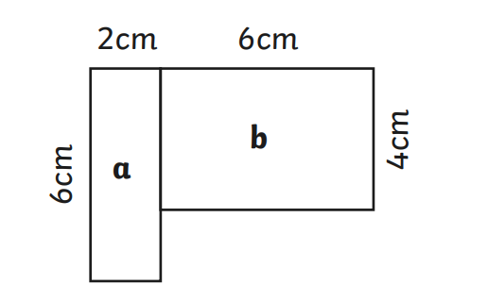
24
7
30
Area
Date
EQ – How we can use formulas to find areas of composite shapes?
This shapes can be split into two rectangles, a and b.
Area a:
6 x 2 = 12 cm²
Area b:
6 x 4 = 24 cm²
Total area = area a + area b
= 12 + 24
= 36 cm²

Slide 3
24
7
30
Area
Date
EQ – How we can use formulas to find areas of composite shapes?
How do we find the area of more complex shapes like the one below?
7cm
Rectangle
Triangle
20cm
5cm
We break it into it’s composite shapes. What two shapes is the above shape made up of?

Slide 4
24
7
30
Area
Date
EQ – How we can use formulas to find areas of composite shapes?
The shape below can be split into 2 pieces, a rectangle and a triangle
+
7cm
7cm
15cm
5cm
To find the area of the whole shape, we find the area of the 2 shapes and add them together.
A=1/2 x base x height
= 0.5 x 7 x 5 cm
= 17.5 cm²
A=length x width
= 7 x 15 cm
= 105cm²
Total area = area of rect. + area of triangle
= 105 + 17.5 = 122.5cm²

